Slide 1



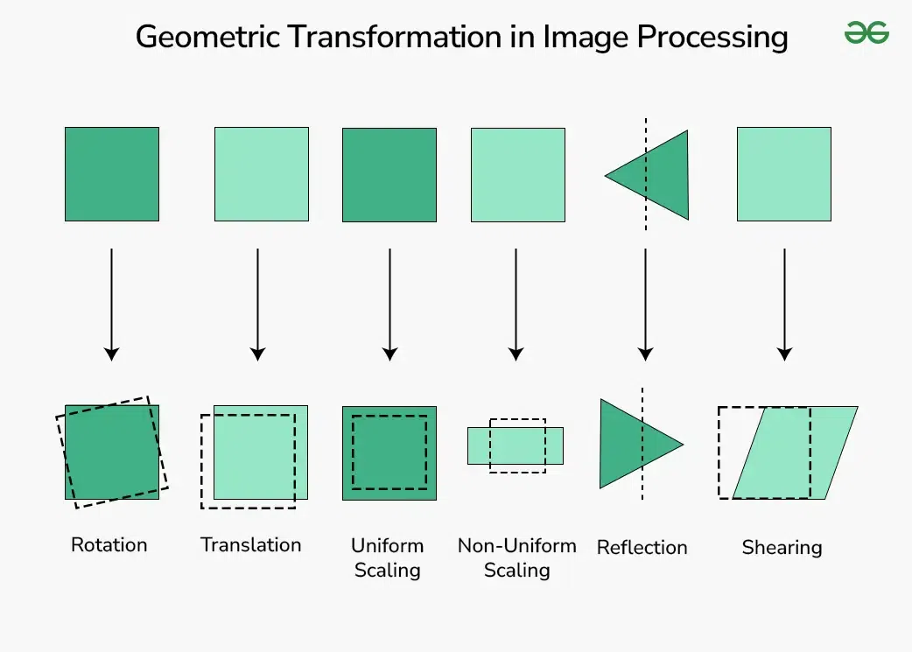
Session 2 :
Introduction to Advanced Image Transformations

Slide 2

Introduction
Image Transformations allow us to reshape and reorient images.
These operations are fundamental for data augmentation, object detection, and image correction in research and real-world applications.

Slide 3
Learning Outcome
Learn to apply scaling, rotation, and affine transformations using OpenCV.
Understand the geometric changes involved and how they affect image structure and analysis.

Slide 4
Understand geometric transformations and their applications.
What are Image Transformations?
Mathematical operations that map pixel coordinates from one space to another.
Used for correcting distortions, aligning images, or creating visual effects.
Types of Transformations:
Scaling: Resize an image (enlarge/shrink).
Rotation: Rotate an image around a point.
Affine: Preserve parallelism (e.g., translation, shearing, scaling, rotation).
Projective (Bonus): Handle perspective changes (homography).
Applications:
Robotics: Adjust camera views for object manipulation.
Augmented Reality: Align virtual objects with real-world scenes.
GIS Mapping: Correct satellite imagery distortions.

Slide 5
Interpolation Methods:
INTER_NEAREST: Fast but pixelated (suitable for pixel art).
INTER_LINEAR: Smooth output (default in OpenCV, ideal for photos).
INTER_CUBIC: Higher quality for upscaling (slower).
Aspect Ratio:
Preserve proportions using fx and fy parameters.
Avoid "stretching" artifacts by calculating dimensions dynamically.
# Scale to 50% with cubic interpolation
scaled_img = cv2.resize(img, None, fx=0.5, fy=0.5, interpolation=cv2.INTER_CUBIC)
Real-Time Examples:
E-commerce: Resize product images to fit responsive web layouts.
Medical Imaging: Zoom into MRI scans for detailed tumor analysis.
Machine Learning: Normalize input sizes for CNN models.
Gaming: Dynamically scale textures for high-resolution displays.

Slide 6
Python Programming Task
Write a Python script using OpenCV to:
- Scale images (resize)
- Rotate images around a center point
- Apply affine transformation using three point mappings
- Display the original and transformed images side by side for comparison.

Slide 7
Scaling Images
Function: cv2.resize(image, (width, height))
- Upscaling makes images larger; downscaling reduces size.
- Scaling is critical when preparing images for models or displaying in uniform dimensions.
Rotating Images
Use:
- cv2.getRotationMatrix2D(center, angle, scale)
- cv2.warpAffine(image, rotation_matrix, output_size)
This rotates the image around a specific point, useful in aligning objects or simulating rotations.

Slide 9

Rotation
Rotation Matrix:
Defined using cv2.getRotationMatrix2D(center, angle, scale).
Angles: Positive values = counter-clockwise; negative = clockwise.
Handling Boundaries:
cv2.BORDER_REFLECT: Mirror edges to fill empty regions.
cv2.BORDER_TRANSPARENT: Ignore boundaries (useful for circular crops).
OpenCV Function:
# Rotate 30° clockwise with mirrored borders
M = cv2.getRotationMatrix2D((width//2, height//2), -30, 1)
rotated_img = cv2.warpAffine(img, M, (width, height), borderMode=cv2.BORDER_REFLECT)
Real-Time Examples:
Photography Apps: Auto-rotate tilted horizons in landscape photos.
OCR Systems: Align skewed text documents for accurate character recognition.
Astronomy: Rotate star maps to match telescope orientations.
Art Restoration: Correct angles of scanned historical manuscripts.

Slide 10
Affine Transformations
Affine transforms preserve lines and parallelism.
Use:
- cv2.getAffineTransform(pts_src, pts_dst)
- cv2.warpAffine(image, affine_matrix, output_size)
Allows rotation, translation, and shearing by mapping three source points to three destination points.

Slide 11
Module : Affine Transformations
Theory:
Requires 3 source points and 3 target points to compute the transformation matrix.
Preserves parallelism but not angles or lengths.
Common operations: Shearing, Translation, Scaling.
# Shear effect: Shift top-right corner
src = np.float32([[0,0], [width,0], [0,height]])
dst = np.float32([[0,0], [width-100,50], [0,height]])
M = cv2.getAffineTransform(src, dst)
affine_img = cv2.warpAffine(img, M, (width, height))
Real-Time Examples:
License Plate Correction: Fix skewed plates in traffic cameras.
Facial Recognition: Align faces to a standard pose.
Video Stabilization: Compensate for camera shake in live feeds.
Industrial Automation: Align parts on conveyor belts for robotic pick-and-place.

Slide 12
Module : Projective Transformations
Homography: A 3x3 matrix for perspective correction.
Requires 4 source and 4 destination points.
Use cv2.findHomography() to compute the matrix.
OpenCV Function:
# Perspective correction for a book cover
src_pts = np.float32([[56,65], [368,52], [28,387], [389,390]])
dst_pts = np.float32([[0,0], [300,0], [0,300], [300,300]])
M, _ = cv2.findHomography(src_pts, dst_pts)
warped_img = cv2.warpPerspective(img, M, (300, 300))
Real-Time Examples:
AR Navigation: Overlay directions onto real-world road perspectives.
3D Reconstruction: Align multi-view images for 3D modeling.
Document Scanning: Flatten curved pages in book scans.
Sports Analytics: Transform stadium camera views to top-down perspectives.

Slide 13
Python Script for Comparison
Apply scaling, rotation, affine, and projective transforms, then display results.
# 2. Rotation (30° clockwise with reflection borders)
M_rotate = cv2.getRotationMatrix2D((width//2, height//2), -30, 1)
rotated = cv2.warpAffine(img, M_rotate, (width, height), borderMode=cv2.BORDER_REFLECT)
# 3. Affine Transformation (shear effect)
src_affine = np.float32([[0,0], [width,0], [0,height]])
dst_affine = np.float32([[50,50], [width-50,50], [0,height]])
M_affine = cv2.getAffineTransform(src_affine, dst_affine)
affine = cv2.warpAffine(img, M_affine, (width, height))

Slide 14
# 4. Projective Transformation (perspective correction)
src_proj = np.float32([[100,100], [400,100], [100,400], [400,400]])
dst_proj = np.float32([[0,0], [300,0], [0,300], [300,300]])
M_proj, _ = cv2.findHomography(src_proj, dst_proj)
projective = cv2.warpPerspective(img, M_proj, (300, 300))
projective = cv2.resize(projective, (width, height)) # Resize for comparison

Slide 15
# Combine all results
combined = np.hstack((img, scaled, rotated, affine, projective))
# Display
cv2.imshow('Transformations: Original | Scaled | Rotated | Affine | Projective', combined)
cv2.waitKey(0)
cv2.destroyAllWindows()

Slide 16
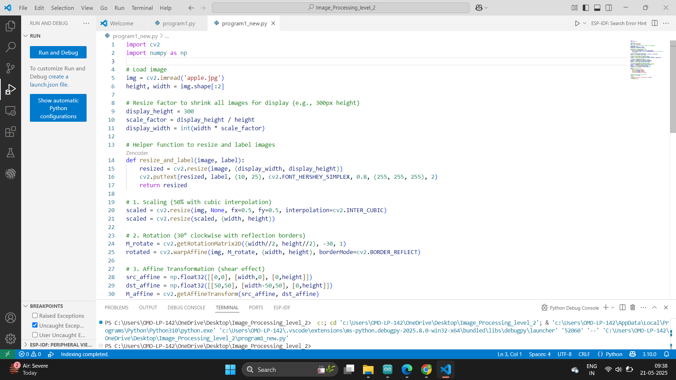

Slide 17
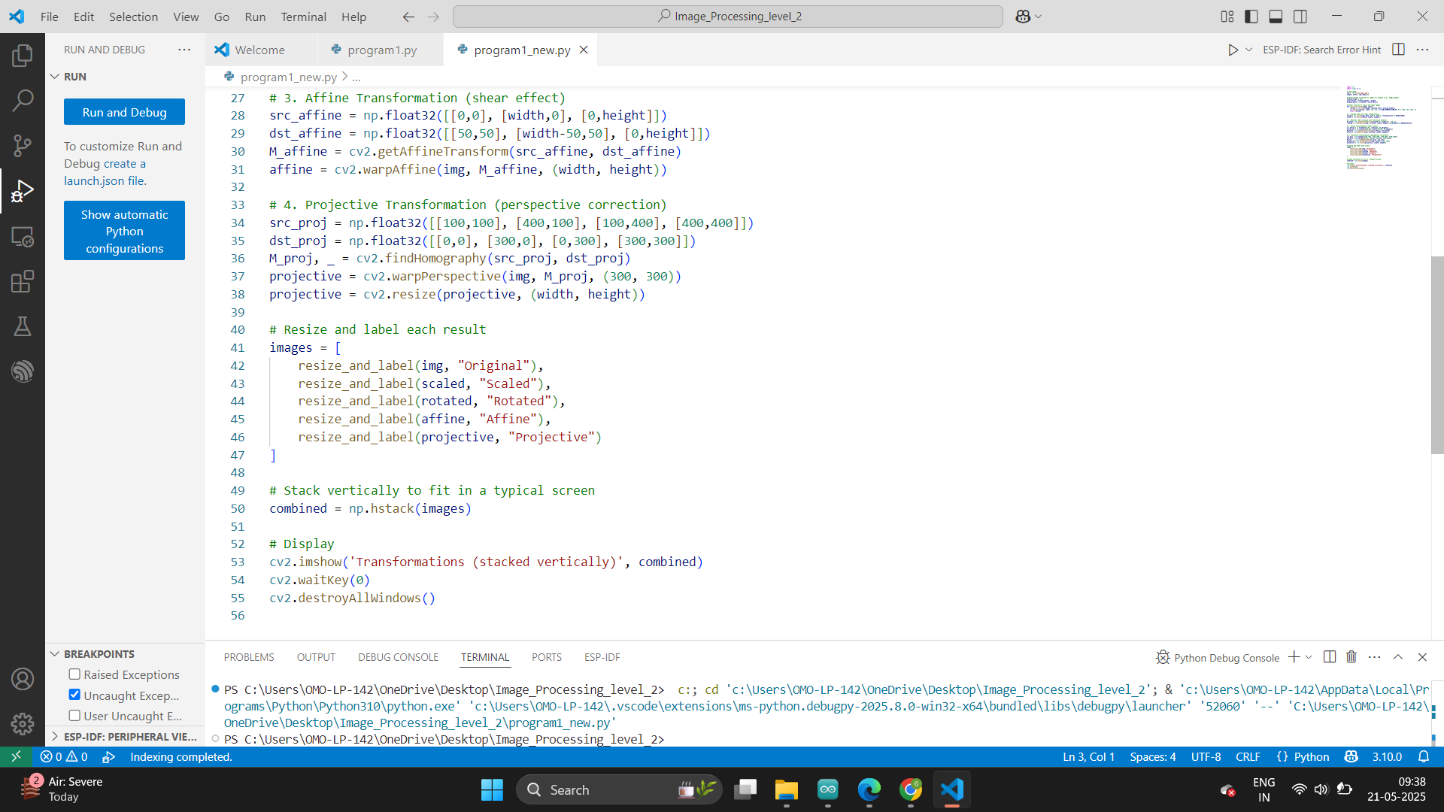

Slide 18
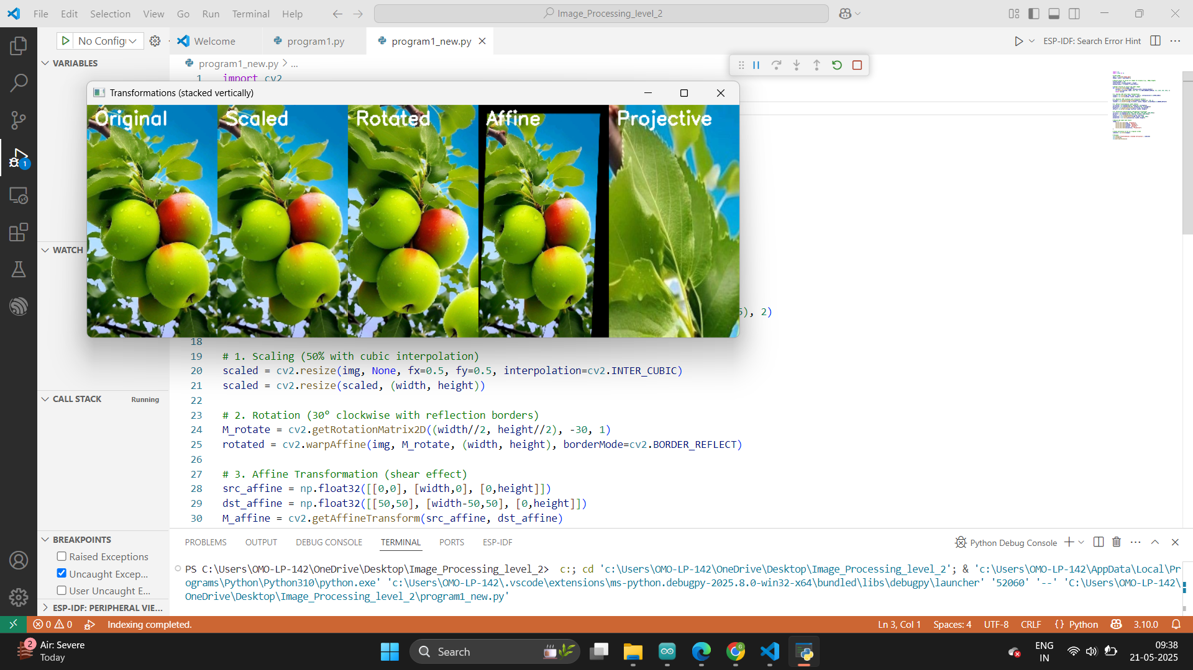

Slide 19
Visualizing Results
Use matplotlib or cv2.hconcat to show:
- Original image
- Scaled version
- Rotated image
- Affine transformed output
This helps observe how each transformation affects image shape and orientation.

Slide 20
Key Functions Summary
cv2.resize(): Image resizing
cv2.getRotationMatrix2D(): Rotation matrix
cv2.warpAffine(): Applies affine/rotation transform
cv2.getAffineTransform(): Generates affine matrix from points
cv2.imshow() or matplotlib.pyplot: Display results

Slide 21
Python Script on Advanced Image Transformations
PART 1
import cv2
import numpy as np
def nothing(x):
pass
image = cv2.imread('image.jpg')
if image is None:
raise ValueError("Image not found!")
rows, cols = image.shape[:2]

Slide 22
Python Script on Advanced Image Transformations
PART 2
cv2.namedWindow('Transformations')
cv2.createTrackbar('Scale (%)', 'Transformations', 100, 200, nothing)
cv2.createTrackbar('Rotation (°)', 'Transformations', 0, 360, nothing)
cv2.createTrackbar('Shear', 'Transformations', 0, 100, nothing)

Slide 23
Python Script on Advanced Image Transformations
PART 3a
while True:
scale = cv2.getTrackbarPos('Scale (%)', 'Transformations') / 100.0
angle = cv2.getTrackbarPos('Rotation (°)', 'Transformations')
shear = cv2.getTrackbarPos('Shear', 'Transformations') / 100.0
# Scaling
scaled = cv2.resize(image, None, fx=scale, fy=scale, interpolation=cv2.INTER_LINEAR)
# Rotation
M_rot = cv2.getRotationMatrix2D((cols/2, rows/2), angle, 1)
rotated = cv2.warpAffine(image, M_rot, (cols, rows))

Slide 24
Python Script on Advanced Image Transformations
PART 3b
# Affine with shear
pts1 = np.float32([[50,50], [200,50], [50,200]])
pts2 = np.float32([[50+shear*50,50], [200+shear*50,50], [50,200]])
M_affine = cv2.getAffineTransform(pts1, pts2)
affine = cv2.warpAffine(image, M_affine, (cols, rows))
cv2.imshow('Transformations', affine)
if cv2.waitKey(1) & 0xFF == ord('q'):
break
cv2.destroyAllWindows()

Slide 25
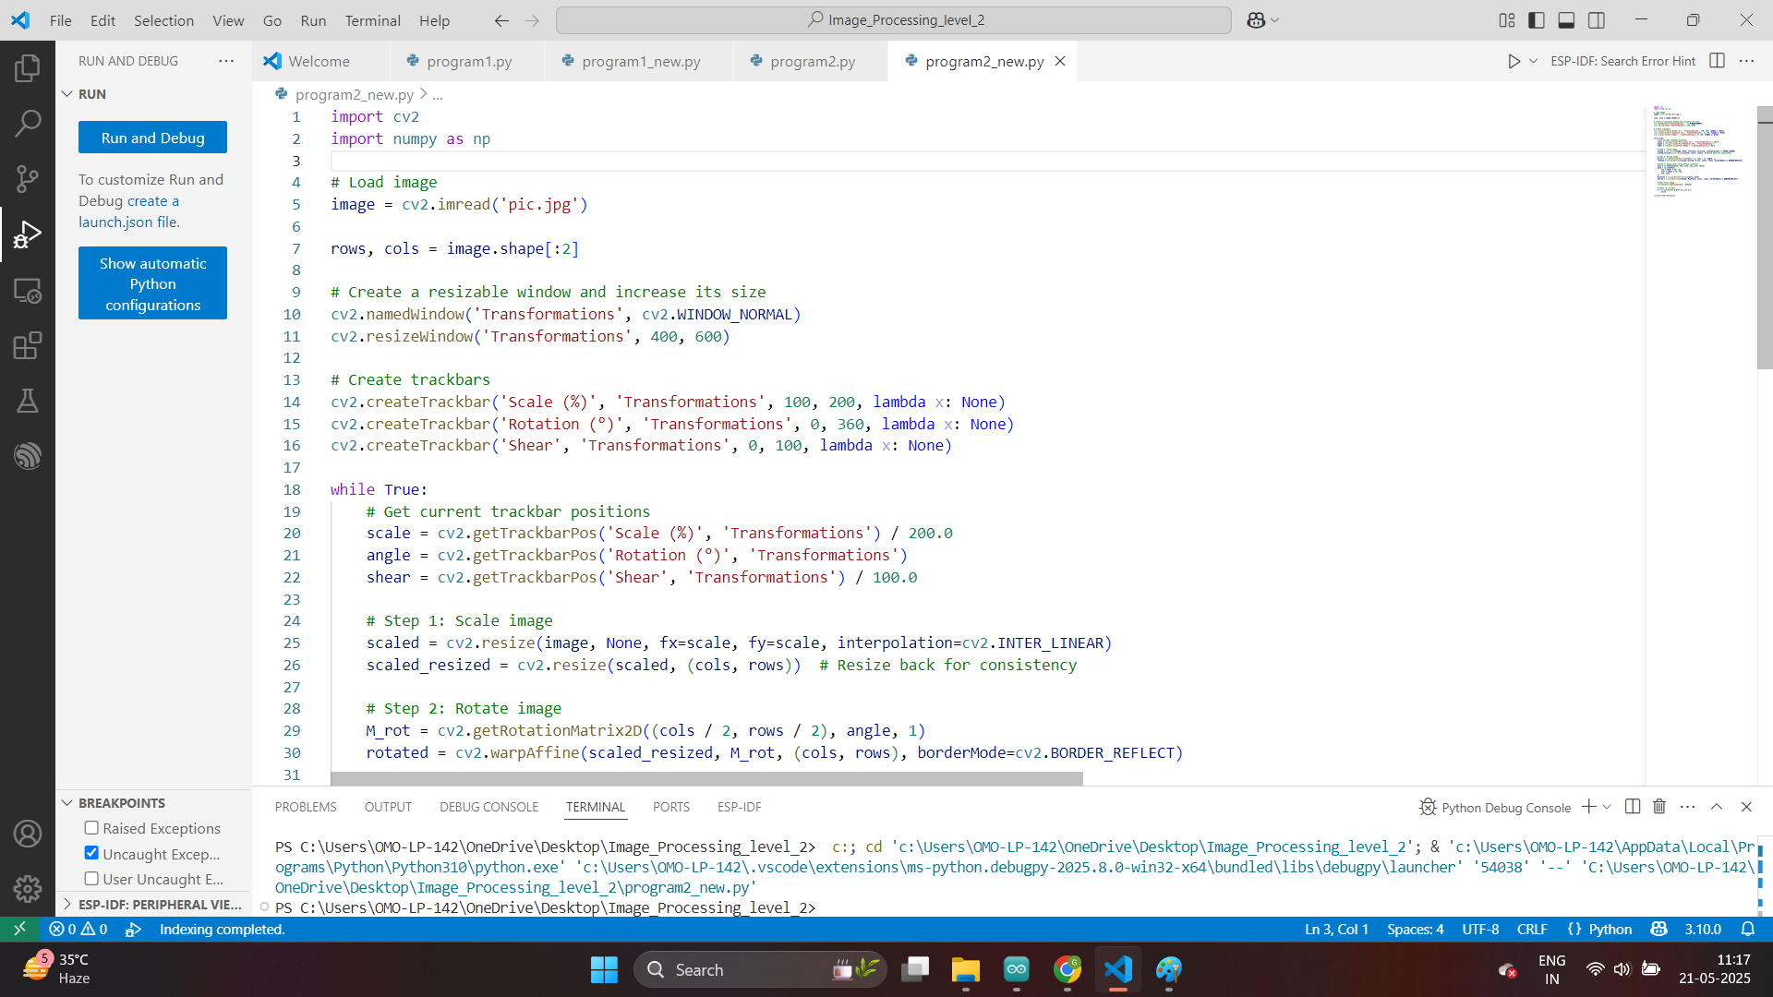

Slide 26
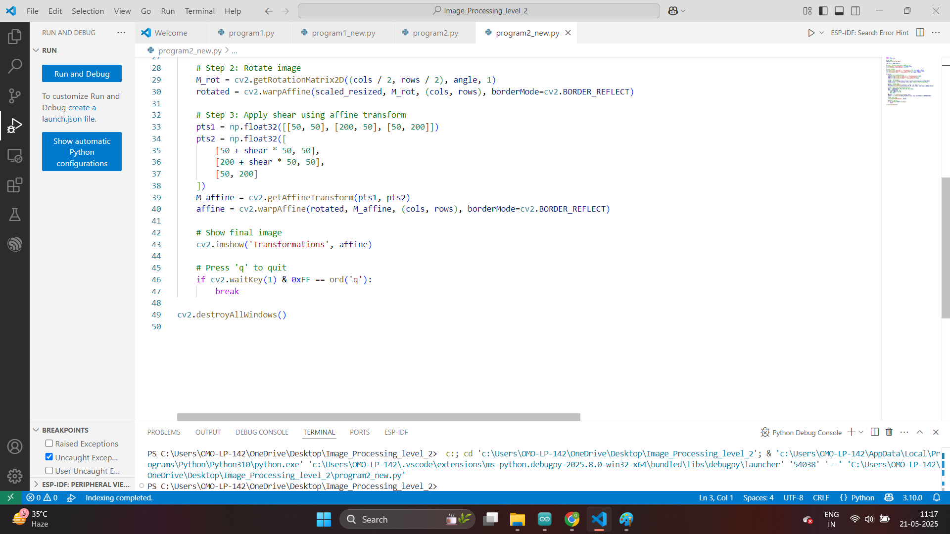

Slide 27
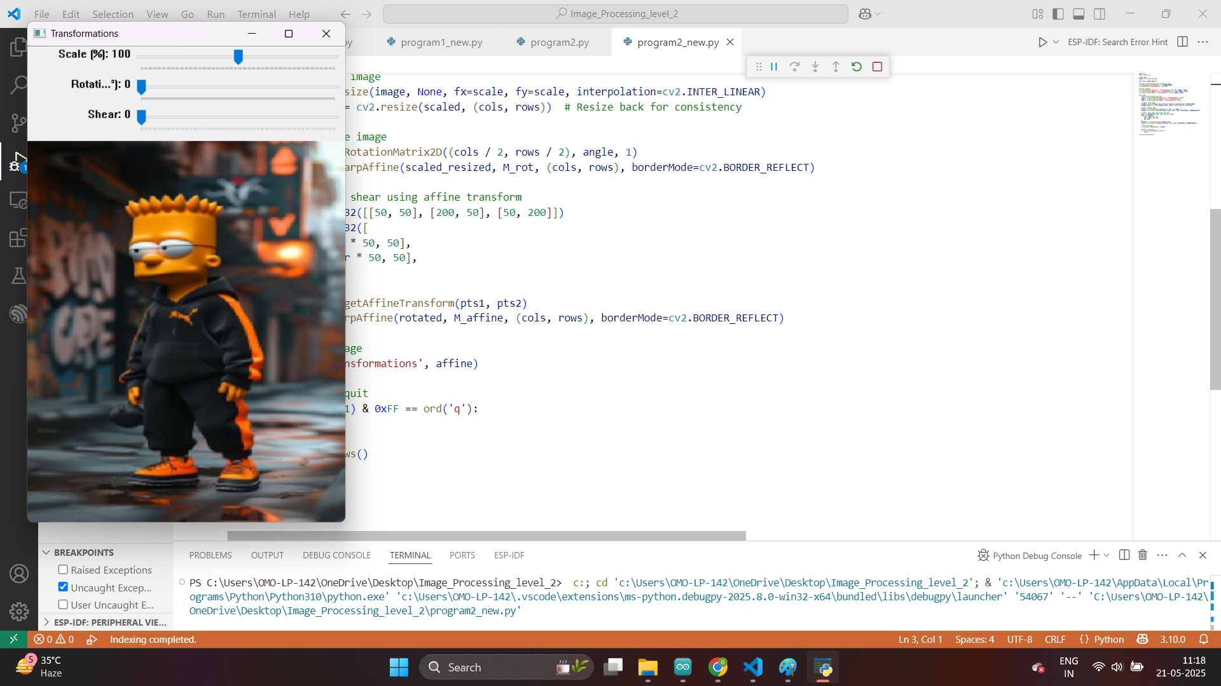

Slide 28
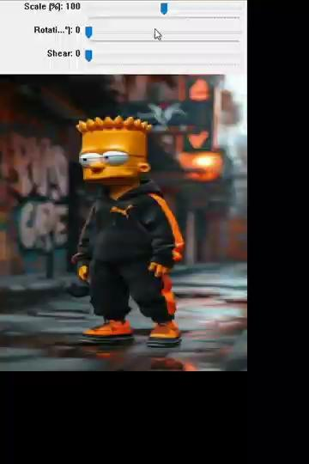
Python Script
Results
Video
Detailing
Various
Scenarios

Slide 29
Applications in Research
Transformations are useful in:
- Augmenting training data for machine learning
- Correcting misaligned scans in medical imaging
- Adjusting orientation in satellite images
- Preparing image input for OCR and facial recognition

Slide 30
Summary & Skills Gained by Student
You now understand and can apply core image transformations.
Skills gained by Student:
- Image scaling, rotation, and affine transformation
- Using OpenCV for real-world image manipulation
- Visualizing and debugging transformation effects

Slide 31
Exercise
1. What does cv2.cvtColor(image, cv2.COLOR_BGR2GRAY) do?
A. Resizes the image B. Applies thresholding C. Converts image to grayscale D. Detects edges
Answer: C
2. Which OpenCV function is used to resize an image?
A. cv2.scale() B. cv2.resize() C. cv2.transform() D. cv2.reduce()
Answer: B

Slide 32
Exercise
3. What interpolation method provides the highest quality when enlarging images?
A. INTER_NEAREST B. INTER_LINEAR C. INTER_AREA D. INTER_CUBIC
Answer: D
4. Which transformation requires three source and three destination points?
A. Rotation B. Scaling C. Affine Transformation D. Projective Transformation
Answer: C

Slide 33
Exercise
5. What OpenCV function is used to rotate an image around a point?
A. cv2.rotate() B. cv2.getRotationMatrix2D() C. cv2.rotation() D. cv2.transform()
Answer: B
6. What happens if aspect ratio is not maintained while scaling?
A. Image will be sharper B. No visual change C. Image will be pixelated D. Image may appear stretched or squished
Answer: D

Slide 34
Exercise
7. In cv2.warpAffine, which parameter represents the transformation matrix?
A. image B. M C. size D. interpolation
Answer: B
8. Which transformation is useful for correcting skewed license plates?
A. Scaling B. Rotation C. Affine Transformation D. Gaussian Blur
Answer: C

Slide 35
Exercise
9. What does cv2.findHomography() compute?
A. Binary mask B. Histogram equalization C. 2x3 affine matrix D. 3x3 projective transformation matrix
Answer: D
10. Which border mode in cv2.warpAffine reflects image content at the boundary?
A. cv2.BORDER_CONSTANT B. cv2.BORDER_REPLICATE C. cv2.BORDER_REFLECT D. cv2.BORDER_WRAP
Answer: C

